Slide 1
Statistics 200b – Spring Semester, 2008 – David Brillinger
Statistical Models
“A statistical model is a probability distribution constructed to enable inferences to be drawn or decisions made from data.”
“… the core topics for for studies up to a masters degree in statistics.”
Target audience – senior undergraduate and graduate students

Slide 2
The morning session of our written MA exam covers Stat 200ab.
“The reader is assumed to have a good grasp of calculus and linear algebra and to have followed a course in probability including joint and conditional densities, momen-generating functions, elementary notions of convergence and central limit theorems.”
Sections end with exercises, chapters with problems.
statwww.epfl.ch/~davison/SM : practicals, errata
Statistical package R (From CRAN – free)

Slide 3
Introduction.
“Statistics concerns what can be learned from data.”
“Applied statistics – methods for data collection and analysis.”
“Theoretical statistics – framework for understanding the properties and scope of methods used in applications.”
Common strand – statistical model
Key feature – variability is represented using probability distributions
Pattern vs. haphazard scatter (systematic and random variation)
Examples of data and statistical models follow

Slide 4
Maize data.
Plants descended from same parents
Half self-, half cross-fertilized
Question – heights the same?
Planted pair, one of each, in a pot
Data
Parallel boxplots
(x-y) vs. (x+y)/2
One sees variability. How to express?

Slide 5
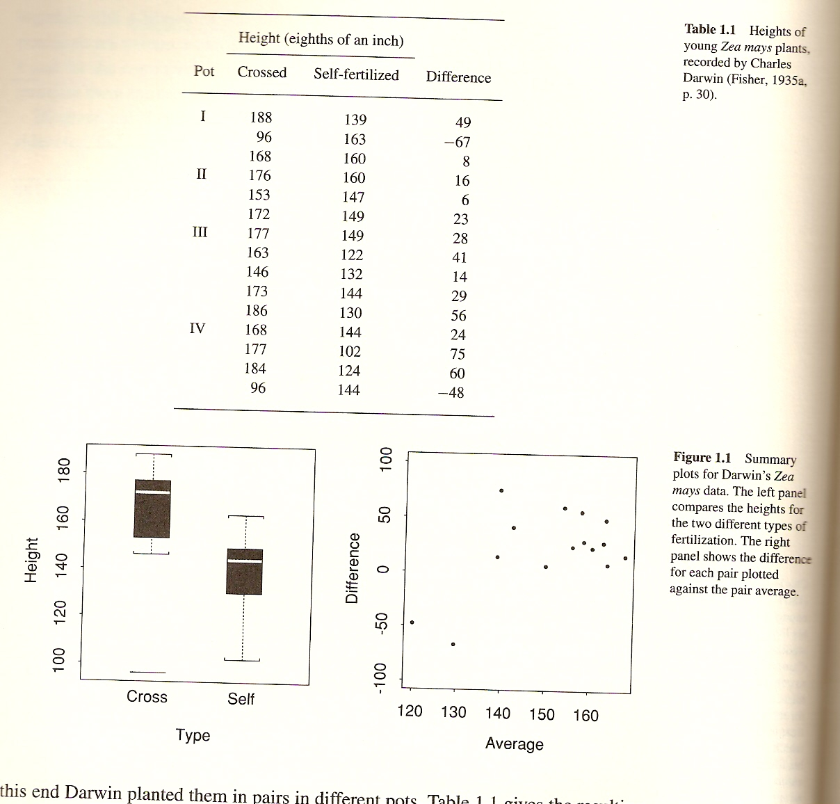

Slide 6


Statistical model. Galton
Self-fertilized,
Y = μ + σε
Cross-fertilized
X = μ + η + σε
μ , η , σ : fixed, unknown quantities Parameters
ε: Random variable, mean 0, variance 1
Questions: is η non-zero
Estimate, variability?
Data n = 15 ,

Slide 7
But j-th pair in the same plot
Subjected to same humidity, growing conditions, light
Y_{j} = μ_{j} + σε_{1j}
X_{j} = μ_{j} + η + σε_{2j}
Eliminate μ by working with X_{j} - Y_{j}

Slide 8
Challenger data.
Space shuttle exploded after launch 28 January 1986
Presidential Commission - cause O-rings not pliable in cold weather or holed in pressure test
Thermal distress
Data
Plot proportions r/m vs temperature x₁ and pressure x₂ m=6
Statistical model, R binomial Bin(m,π), R=1,...,6
π = e^{u} /(1+e^{u})
u = β₀ + β₁ x₁ + β₂ x₂

Slide 9
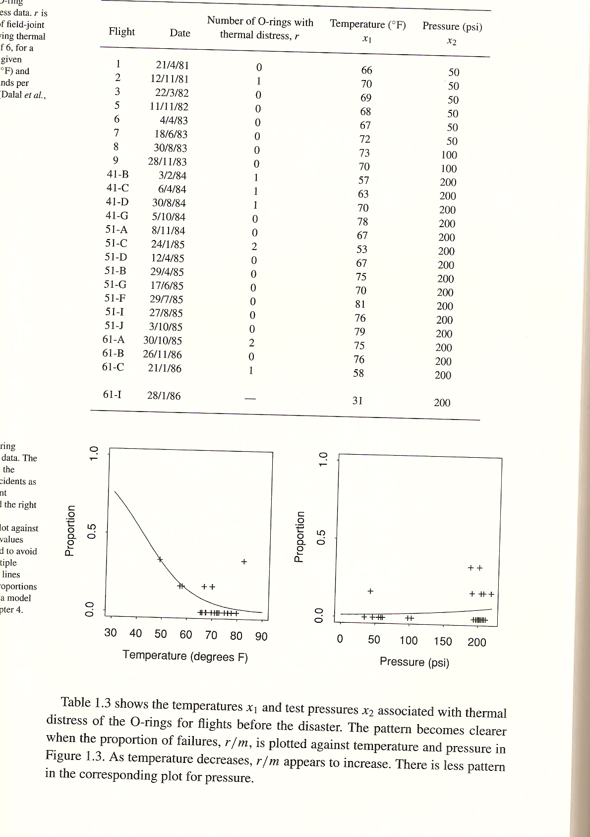

Slide 10
Lung cancer data
Cigarette smokers amongBritish male physicians
Table of counts - years of smoking by daily cigarettes
Plot of deaths per 1000 man-years of smoking vs. years of smoking
Three cases more than 20 cigs/day, 1 to 19/day, 0/day
Y number of deaths, Poi(Tλ(d,t)), y=0,1,2,...
T: total man-years at risk in category
λ(d,t): death rate for those smoking d cigarettes per day after t years of smoking
λ(d,t) = β₀ exp{log t β₁}(1 + β₂ exp{log d β₃}
Expect all β's positive

Slide 11
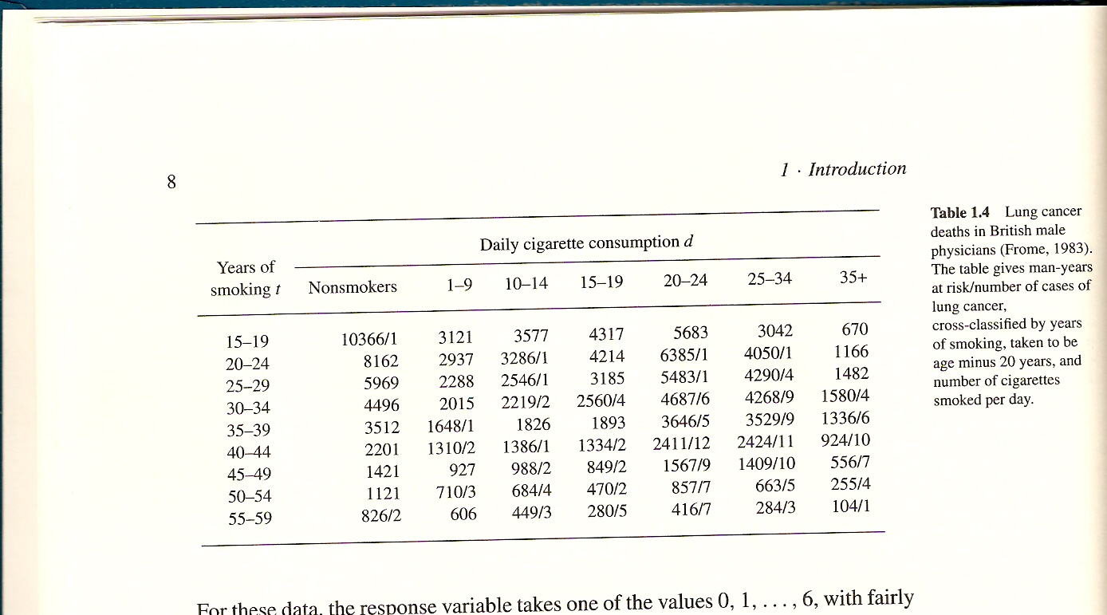

Slide 12
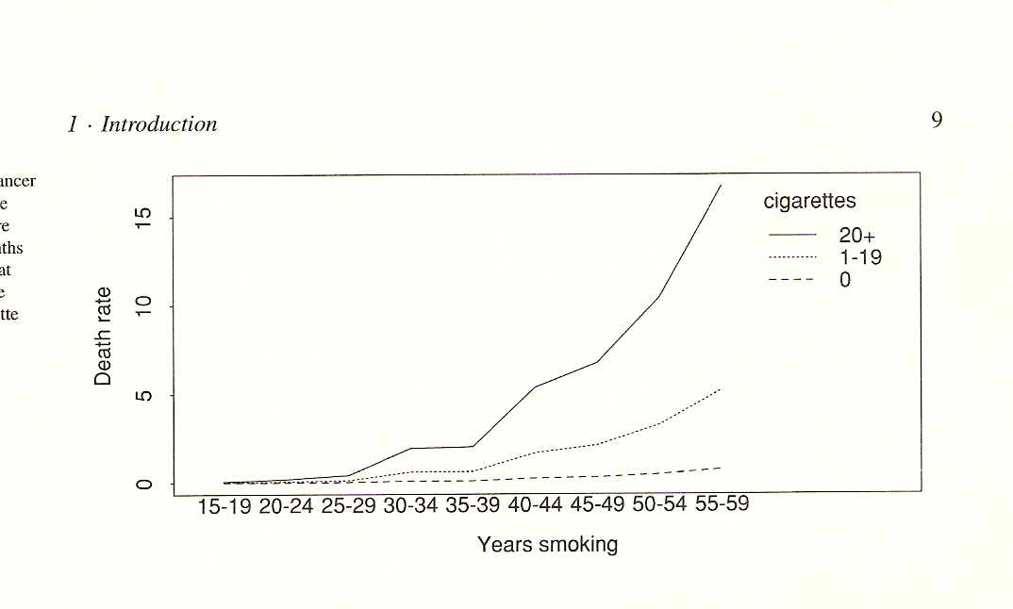

Slide 13
The idea of treating data as outcomes of random variables has implications for how they should be treated, Variability. Chapter 2 is devoted to this.
Chapter 3 explains one of the main approaches to expressing uncertainty, leading to the construction of confidence intervals
Likelihood is a central idea for parametric models, and it and its ramifications are described in Chapter 4.
Chapter 5 describes some particular classes of models.
Chapter 7 discusses more traditional topics of mathematical statistics, with a more general treatment of point and interval estimation and testing

Slide 14
Regression models describe how response variable, treated as random. depends on explanatory variables, treated as fixed. Chapter 8 describes the linear model.
Chapter 9 discusses the ideas underlying the use of randomization and designed experiments
Chapter 10 is devoted to nonlinear models. It starts with likelihood estimation using the iterative weighted least squares algorithm, which subsequently plays a unifying role and the describes generalized linear models.
The main links among the chapters of the book are shown in the next figure.

Slide 15
